Slide 1

Group 1
MAHST
Mini At-Home Solar Thermal
Power Generation
Homa Amini Manesh
Aaron Birencwaig
Nitesh Champaneri
Jonathan Wise

Slide 2


Motivation
Recent Catastrophe With Non-Green Energy Sources:
13,000 death each year attributed to power plant pollution according to the Clean Air Task Force study in 2000 and 2004.
Upper Big Branch Mine disaster
Japan’s Recent Nuclear Meltdown
Gulf Oil Spill
Problems With Traditional Power Generation:
High Cost
Limited Supply of Fossil Fuel
Lack of Economic Independence

Slide 3

Solution
To prevent these problems, making use of a clean renewable energy source is ideal. Our solution is to combine both solar thermal and solar photovoltaic panel technologies into a single power generating unit known as MAHST. MAHST stands for Mini At-Home Solar Thermal power generation.

Slide 4
Goals and Objectives
MAHST Offers:
Clean and Renewable Source of Energy
Affordable for Average Household
User Friendly
Power Grid Independence
Portability
Efficiency

Slide 5
Specification
Stirling engine generates 10 watts peak power at 12 volts under ideal conditions
PV panel produces peak power outputs of 30 watts at 24 volts
Total power of 40 watts maximum under ideal conditions
Two 12 V DC lead acid Absorbent Glass Mat batteries
5 V, 600mA switching regulator powering two microcontrollers
12V, 700mA DC/DC switching regulator powering the tracking system motors
The monitoring system displays:
Temperature of the battery to within ±1°C of accuracy
Power being generated within ±2 watts of the actual value
Voltage of the battery within ±0.5 volts of the actual value
5 V DC, 700mA USB power outlet
12 V DC power outlet

Slide 6
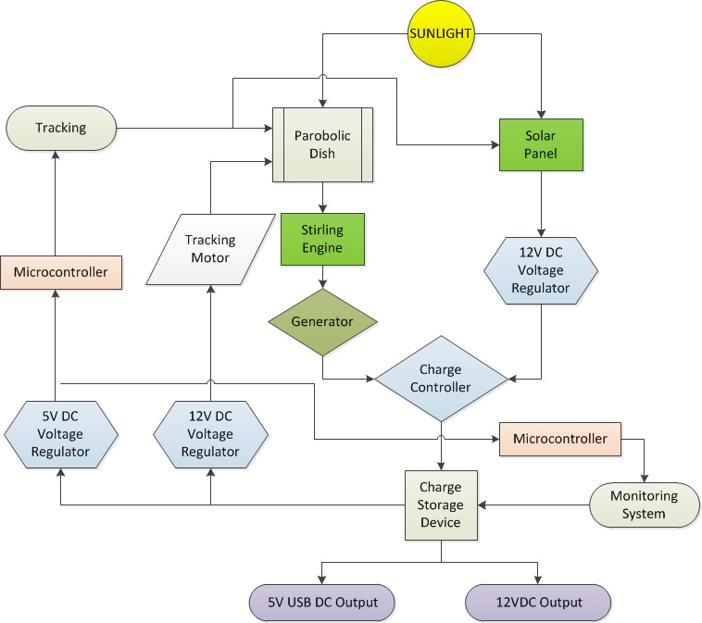
Block Diagram

Slide 7
Hardware Components

Slide 8
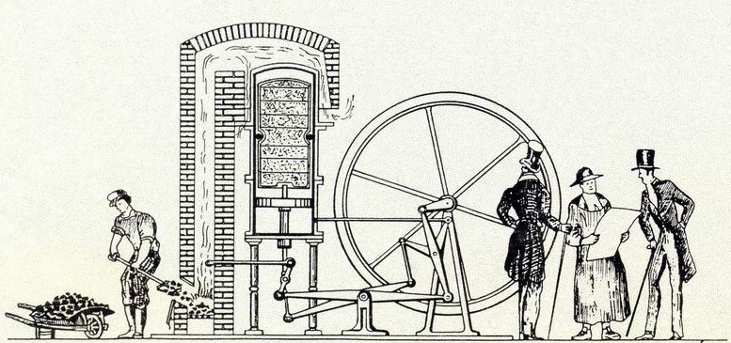
Stirling Engine
Invented in 1816
Advantages
One of the cleanest and most efficient heat engines
Runs on any source of heat
Its working fluids may consist of air, helium, or hydrogen
Safe because of its closed system
Different types of engines for different applications
The Stirling Engine of 1816

Slide 9
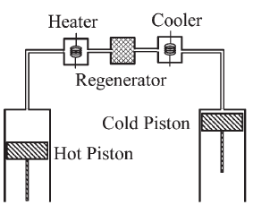
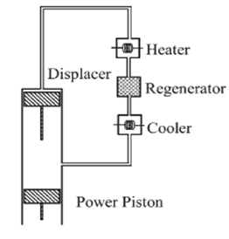
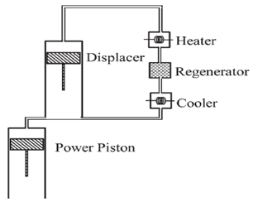
Types
Alpha-α Beta-β Gamma-γ
Stirling Engine

Slide 10
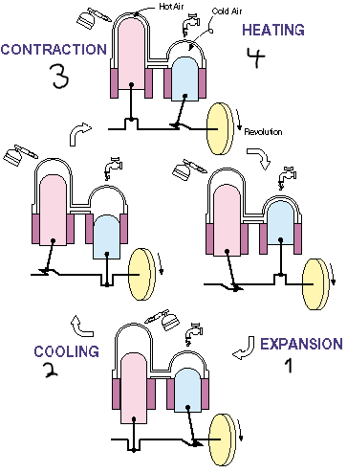
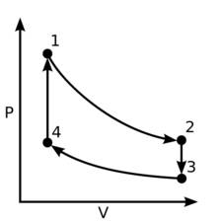
Stirling Engine
Mechanism
Hot and cold heat exchanger
Hot heat exchanger is in the direct contact of an external
heat source
Four thermodynamic processes
Movement of the working fluids between the hot and cold
heat exchangers
Ideal Gas Law: PV=nRT

Slide 11
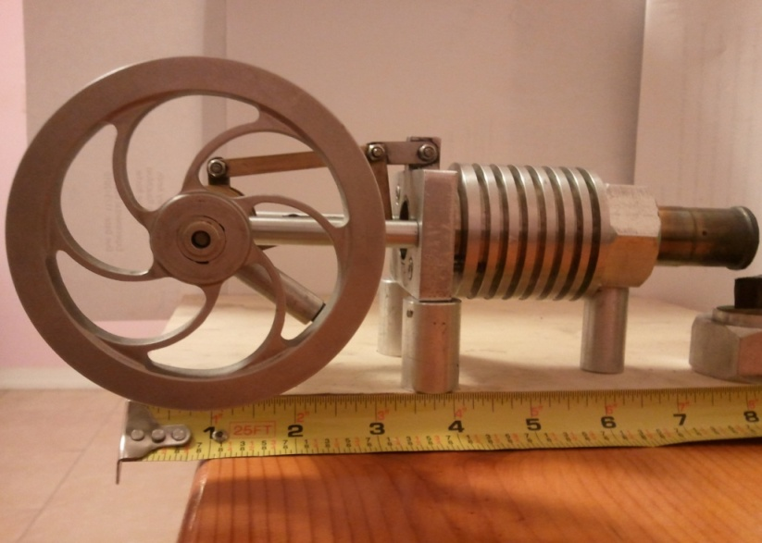
Stirling Engine
Characteristics
Made in New Zealand
Beta-β Type
Driving a small DC generator
Specifications
2 volts / 100 rpm
10-15 volts
Output Power:10 Watts
Thickness of Hot Cap: 0.0039 - 0.0059 inches
Required Heat : 932-1112°F
Cost: $ 315.00

Slide 12
Solar Panel
Model: GSE 30 Watts
Advantages
Thin film Copper Indium Gallium diSelenide (CIGS)
Higher Conversion Efficiency
No light induced degradation
Designed for charging 12 and 24 volt lead acid batteries
25 years Warranty
Lightweight
Easy to install
Includes a junction box with a by pass diode
FREE!!!

Slide 13
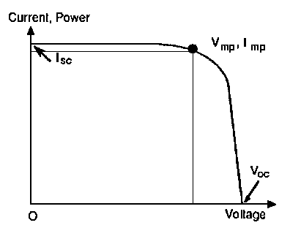
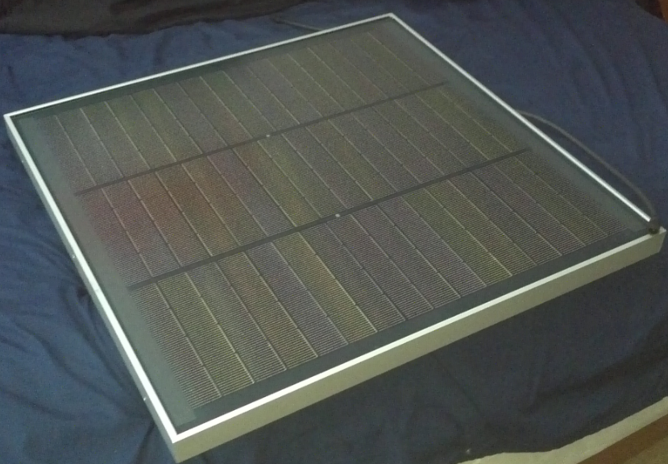
Solar Panel
Specifications
Model: GSE 30Watts
Peak Power Voltage: 17.5V
Peak Power Current: 1.7A
VOC : 25V
ISC : 2.2A
Length x Width : 24.4 x 25(inches)
Weight : 11 lbs
Cost (if we would of purchase one): $289

Slide 14
Reflective Dish
Provides the heat source for the Stirling cycle motor
Reflects light into a single focal point amplifying the heat
Utilizes mirrors or Mylar to reflect heat energy from the sun

Slide 15
Reflective Dish Construction
The reflective material must imitate the dish’s parabolic form
Glass or plastic silver backed mirrors seem to generate the most intense focal point
The wider the focal point, the less heat can be generated by the dish

Slide 16
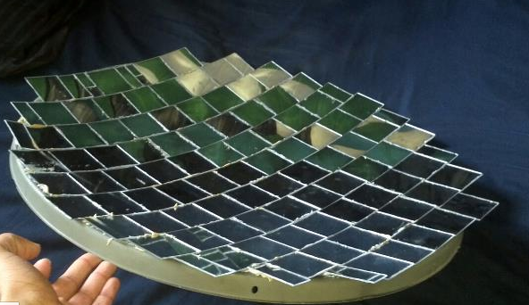
Surface Area of a Parabolic Dish
The surface area must be known for mirroring purposes and to see if sufficient heat can be generated
The general equation of a parabola is when a is and f is the focal point

Slide 17
Surface Area of a Parabolic Dish
The focal point can be found with the equation
= 12 inches where D is the diameter and d is the depth of the dish
The surface area of any parabolic dish can now be found with the equation
= 479.5 in^2

Slide 18
Tracking System
What is a solar tracking system?
A tracking system is a setup that will enable the
user to follow the sun across the sky
Purpose of using a tracking system:
1. Maximize the amount of energy that is capable of
being produced by the solar cells
2. Provide solar cells with more direct sunlight.
3. Allow cells to receive more hours of sunlight.
4. Permits Stirling engine to run for more hours a day
5. Enables the dish to create a higher overall
heat

Slide 19
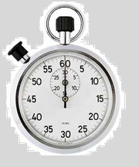

Timed Tracking
System
Advantages
Less power consumed by turning engines
Better tracking of the sun with cloud blockage
Returns to starting position after sunset
Preprogrammed rotation times

Slide 20
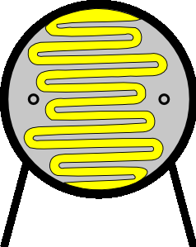
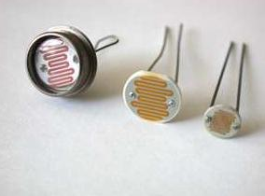
Tracking System With Light Sensors
Photo resistors or photoconductors decrease resistance with increasing incident light intensity .
Made from high resistance semiconductor material.

Slide 21
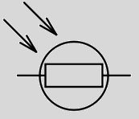
Tracking System With Light Sensors
Voltage differences can be sensed by the microprocessor as the resistance decreases in one of the resistors when two resistors are in series and one is fixed.
The microcontroller will be programmed to instruct the motor to turn towards the resistor with the least resistance allowing for the tracking system to point towards the brightest light source.

Slide 22
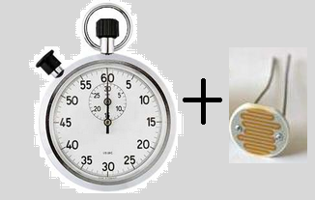
Timed Tracking System With Fine Tuning Resistors
A timed tracking system will only allow for the motors to turn at proper intervals to nearly the correct location in which the sun will be located, then fine tuning can be used with photo resistors in order to point directly at the sun with the most accuracy.

Slide 23
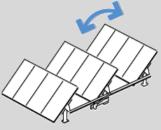
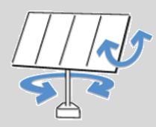
Tracking System
(Two Degrees of Freedom)
Increases the amount of energy created by solar cells from 20-60% compared to cells without a tracking system
Allows for more parallel rays of light to be captured than a system with a single degree of freedom.
1 Degree of Freedom
2 Degrees of Freedom

Slide 24
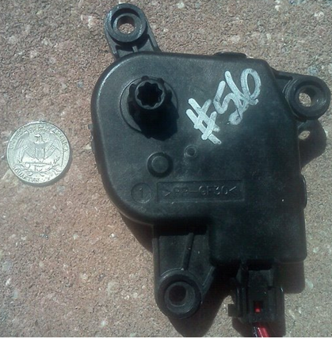
Motors for Tracking
Low revolution high torque motor
Geared motor
12V motor .020 Amperes without load
4 Revolutions a minute
Part# PP GF30 Approximately $5.00, used in the automotive industry

Slide 25
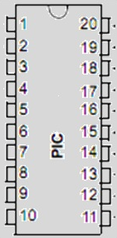
Microcontroller for
Tracking System
PIC 16F690 Microcontroller
8MHz with 7Kb of memory
-40 º F – 257 º F
Rated for forty years
20-Pin Flash-Based
Operating voltage 2.0-5.5V
Low power and power saving options

Slide 26
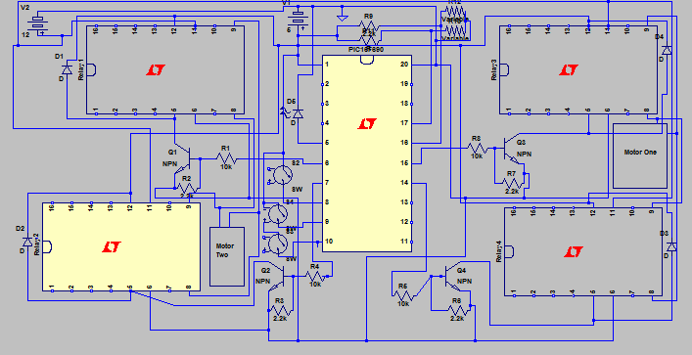
Tracking System Circuitry

Slide 27
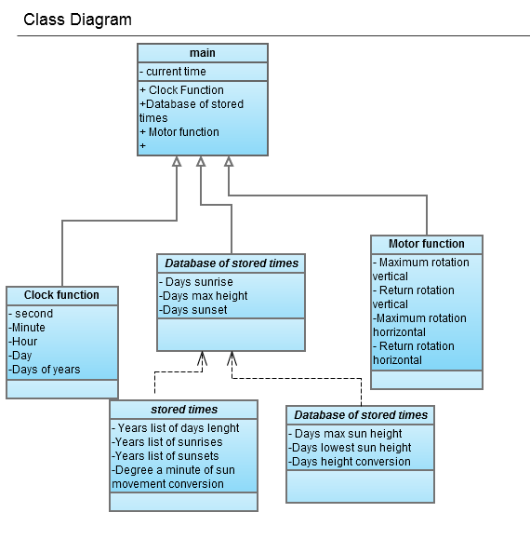
Tracking System Diagram

Slide 28
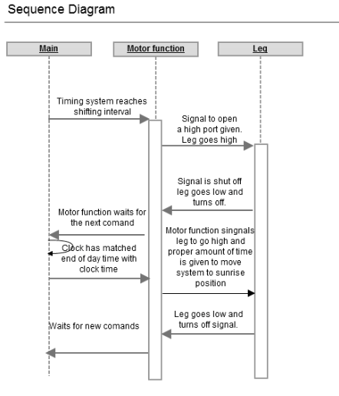
Sequence of Timing System Events

Slide 29
MAHST Monitoring System
Goals and Objectives
Display power generated
Display battery charge state
Display the temperature inside the MAHST unit

Slide 30
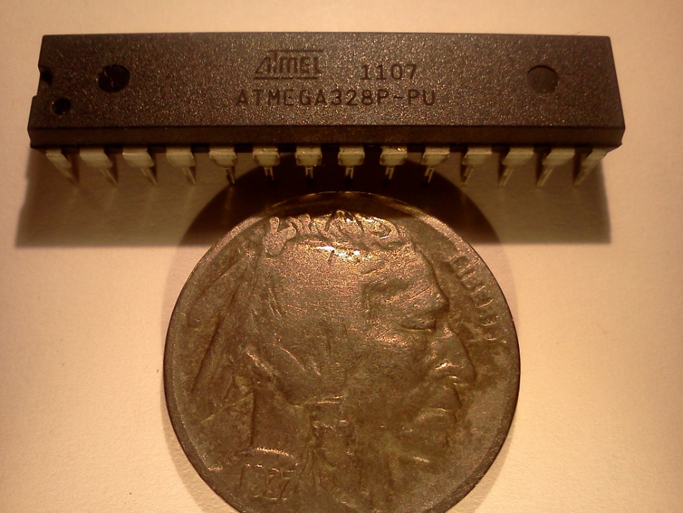
Atmel ATmega328p
28 pin DIP package
1.8v – 5.5v operating range
32kb of flash memory
23 programmable I/O lines
6 ADC channels
10 bit ADC
Boot loader support
Compatible with Arduino UNO
$4.30

Slide 31
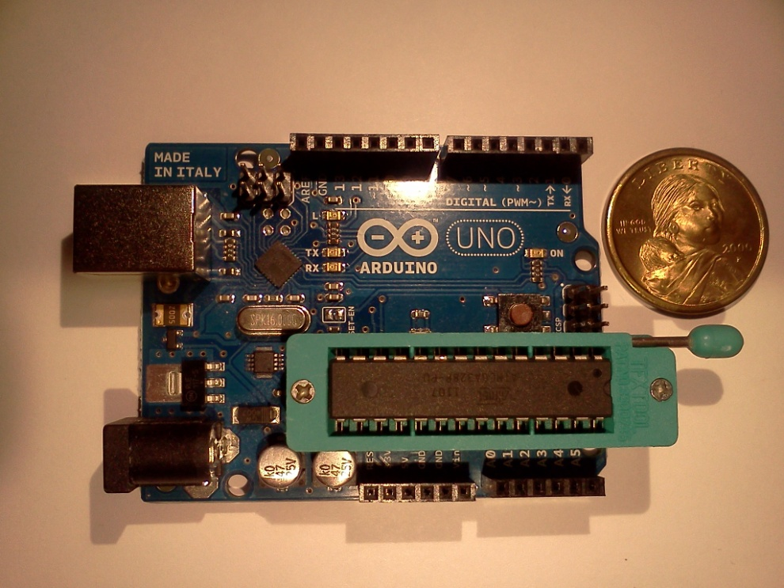
Arduino IDE and UNO Board
Programmable in C
Extensive list of hardware libraries
Simple layout and easy to use
No code size limitations
Large support community
Open source/free
UNO board with ATmega328p
$26.95

Slide 32
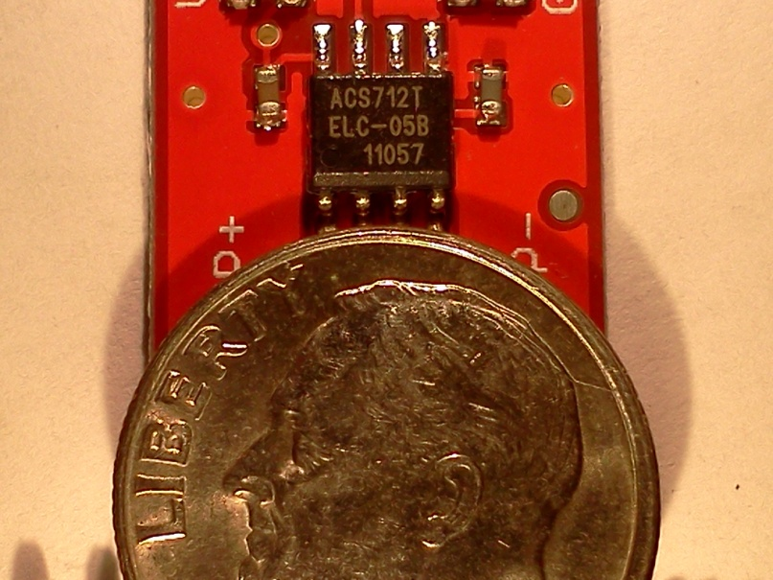
Allegro ACS712 ELCTR-05B-T
Current Sensor
Senses both AC and DC currents
Measures up to ±5 amps
4.5 to 5.5 V supply voltage
-40 to +85°C operating range
±1.5% error at TA = 25°
$4.52
Output voltage is a linear function of input current
V = (1/5)I+2.5

Slide 33
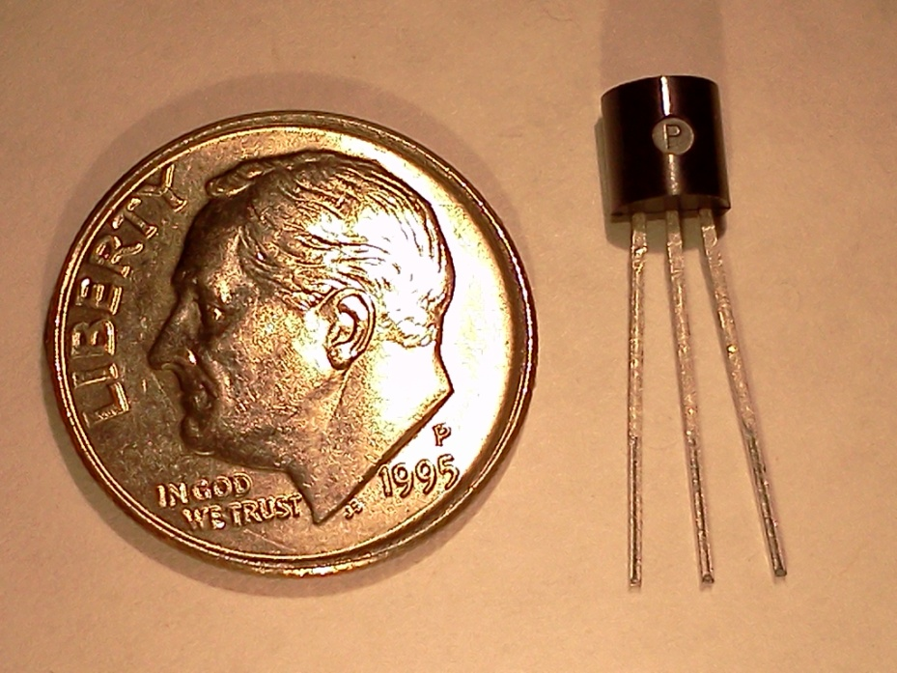
TMP37 Temperature Sensor
Normal range of 5 - 100°C
Normal accuracy ±1°C
Extended range >125°C
Extended accuracy ±2°C
Supply voltage of 2.7 – 5.5V
$1.68
Output voltage is a linear function of temperature
V = 0.02T

Slide 34
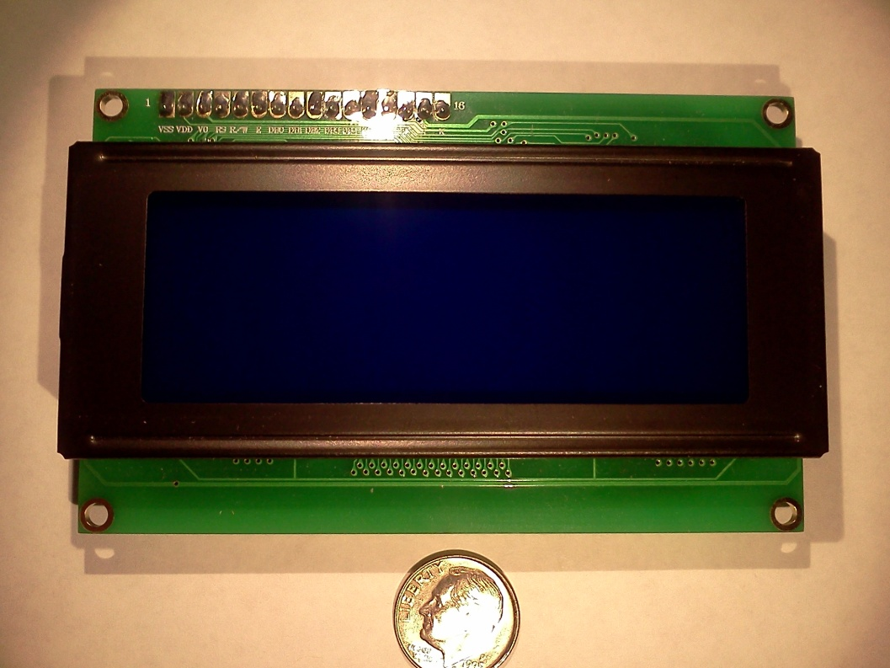
Character Display
Displays 20X4 characters
Based on Hitachi HD44780
Compatible with Arduino
$19.95

Slide 35
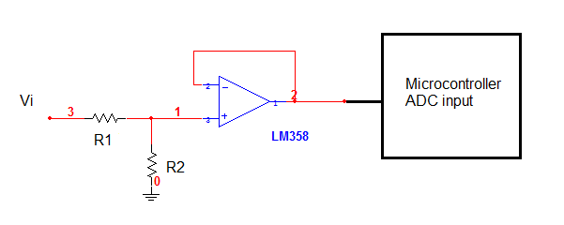
Voltage Sensing
Need voltage scaled down to the µController’s 5V ADC range
Power dissipation should be as small as possible
Need output impedance of sensor to be less than 10kΩ
Op-amp allows for the output impedance to be lower than 10kΩ
R1 = 200kΩ, R2 = 100kΩ for 15V input max
R1 = 400kΩ, R2 = 100kΩ for 25v input max
Resistor ratios allow the max input current to be 50µA

Slide 36
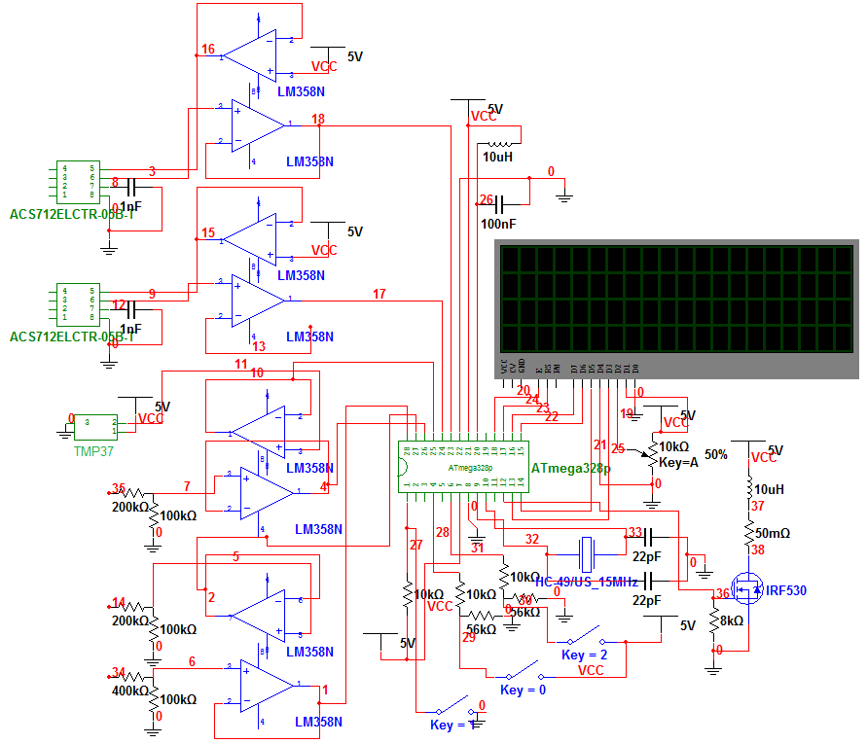
Schematic Diagram

Slide 37
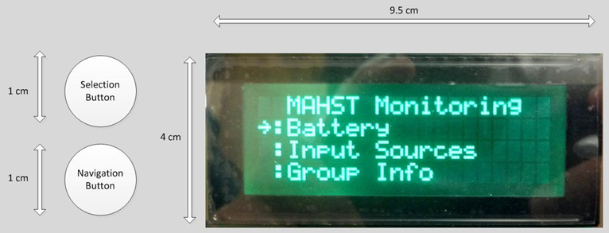
Monitoring System User Interface

Slide 38
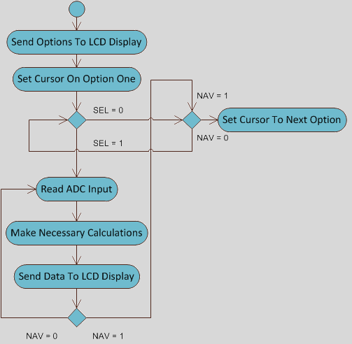
Monitoring System Program Flow
Two variables SEL and NAV correspond to the selection and navigation buttons of the user interface. They allow the user to navigate through the MAHST monitoring system menu.

Slide 39
Monitoring System Functions
float TMP37(int AR);
Automatically converts the analog reading into a Fahrenheit temperature using the linear equation T= 50V*1.8+32
float VFT(int AR);
Allows for the analog voltage readings to be converted to the sensed voltage using the scale factor of the resistor ratio
float VTF(int AR);
Converts voltage readings for the 25V max sensor to a float value.
float Current(int AR);
Returns a float with the value of the current to two decimal places. And makes corrections for nonlinearities. I = (V-2.5)*5

Slide 40
Charge State Functions
float BCSA(void);
This function estimates the charge state of the battery by using the parameters listed below. The function will display a “N/A” charge state when the generators are not producing energy, and “Charging” when the sources are producing. Once the conditions in the function are satisfied, the “charge” variable is set to 64800 coulombs.
Panel voltage
Battery charging voltage
Current being generated by the sources
Net current entering the battery
float DCSA(void);
This function determines the decreasing charge state of the battery. It runs in the background of the monitoring system, and measures the current leaving the battery each second. Then the function either decreases or increases the “charge” variable based on the amps entering or leaving the battery per second.

Slide 41
Monitoring System Accuracy
Testing | In lab | Real world
Voltage(15) | ±20mV | ±50mV
Voltage(25) | ±30mV | ±70mV
Current | ±50mA | ±50mA

Slide 42
Energy Storage

Slide 43
Battery Types
Starting
Used for starting and running the engine
Provides large amounts of current
30-150 deep cycle life
They will last more than thousand normal cycles
Deep Cycle
Could be discharged up to 80% time after time
Has less surface area thus less instant power
Best to keep them at 50% discharge cycle

Slide 44
Battery Material
Nickel-Cadmium
Nickel-metal hydride
Lithium-ion
Lithium-ion polymer
Lead-acid
Mature technology
Better storage capacity
Cost effective
Self discharge rate about 40% a year
No memory effect
Saves natural resources since its fully recyclable
If used correctly they can last 5-8 years

Slide 45
AGM Advantages Over Gelled & Flooded Batteries
Cannot spill, even if broken
Non-hazardous (low shipping cost)
Immune to freezing damage
Temperature stays low even during heavy charge and discharge current
Sit in storage for much longer period
Withstand shock and vibration better than any standard battery
No maintenance
Completely sealed against fumes

Slide 46
Battery Characteristics
Brand – Power Sonic
Model – 12180 B
Nominal Voltage – 12 volts (6 cells)
Nominal Capacity – 18Ah/20h = 900mA
Weight – 12.6 lbs. (5.72Kg)
Internal resistance – 14 milliohms
Max discharge current – 54 A
Operating Temperature
Charge – -4F to 122F
Discharge – -40F to 140F

Slide 47
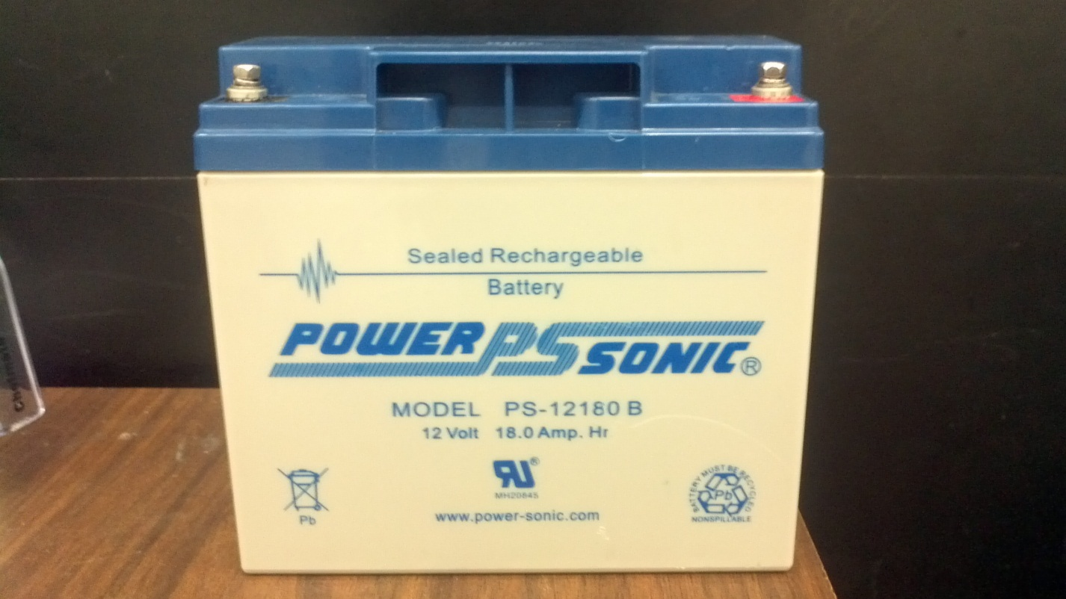
Battery Dimensions
Length – 7.13 inches
Width – 3.00 inches
Height – 6.59 inches

Slide 48

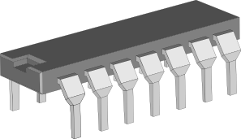
Voltage & Charge Regulators
6 Voltage Regulators
Tracking system microcontroller – 5V, 600mA
Monitoring system microcontroller – 8V, 1.5A
Tracking system motors – 12V, 700mA
Solar panel – SEPIC converter – 14.5V, 2.2A
Powering NE555 for charge controller – 5V, 1.5A
USB 2.0 charger output – 5V, 600mA
Charge Controller

Slide 49
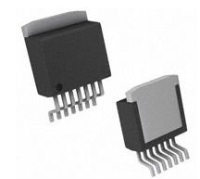
Voltage Regulator
(Powering Tracking System Microcontroller)
LM2676S -5.0
Switcher High efficiency (94%) Step-down Voltage regulator
2% maximum output tolerance
Junction temperature range -40 to +125 C

Slide 50
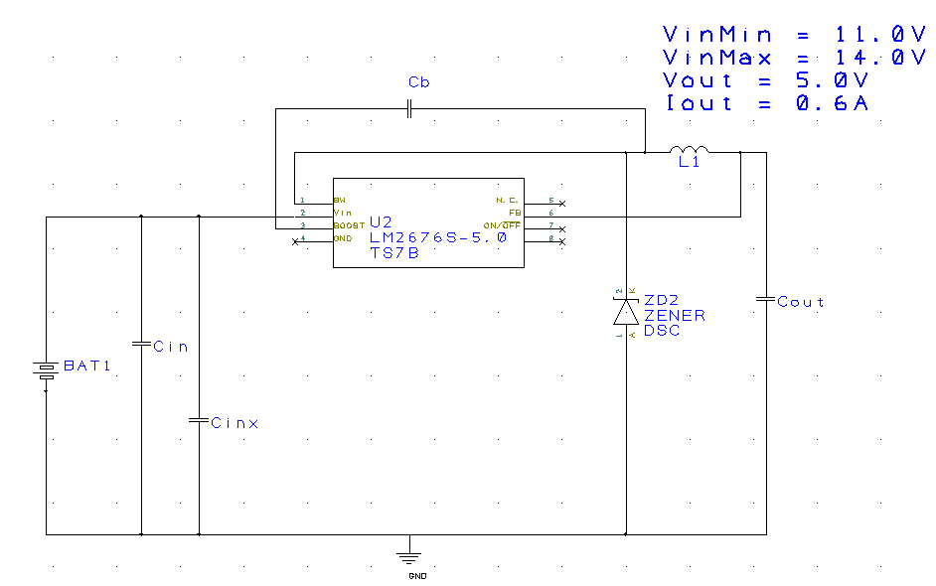
Voltage Regulator Schematics
(Powering Tracking System Microcontroller)

Slide 51
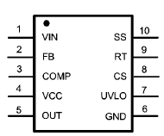
Voltage Regulator
(Powering 2 Tracking System Motors)
LM5022MM
Boost and Single-ended primary inductor converter (SEPIC)
DC-DC converter
Allows the output to be greater than, less than or equal to its input
To power two tracking system motors

Slide 52
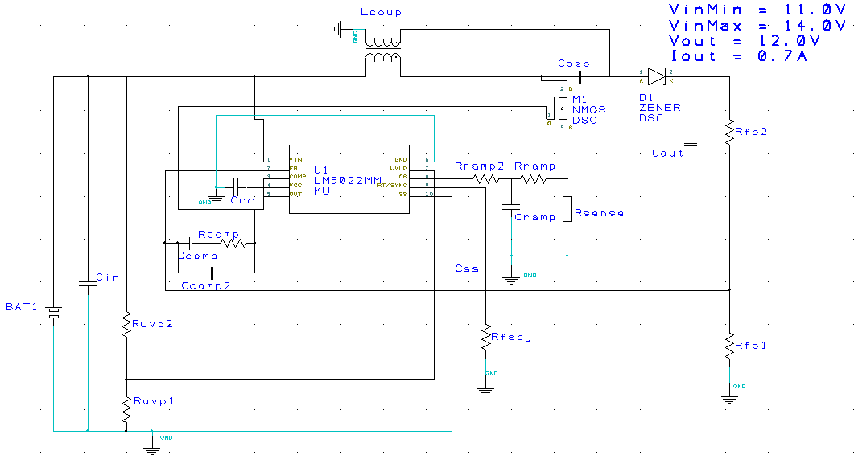
Voltage Regulator Schematics
(Powering 2 Tracking System Motors)

Slide 53
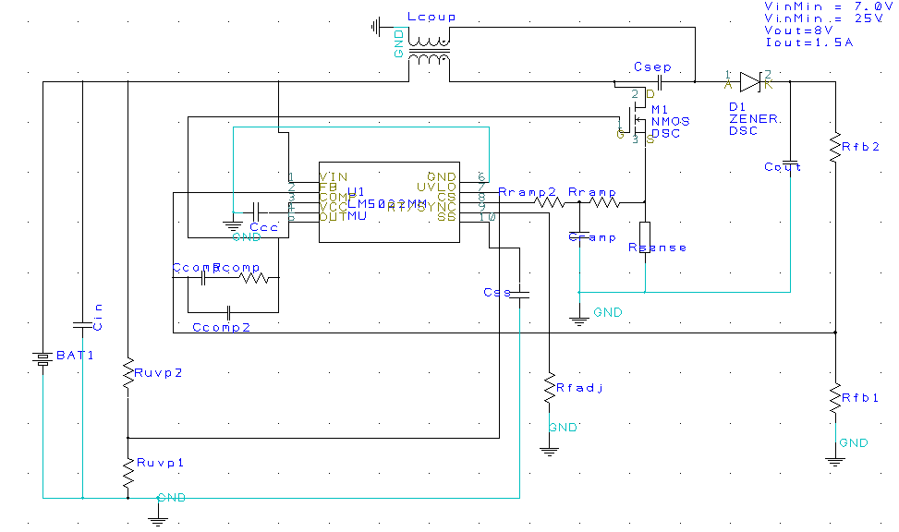
Voltage Regulator Schematics
(Powering Monitoring System Microcontroller)

Slide 54
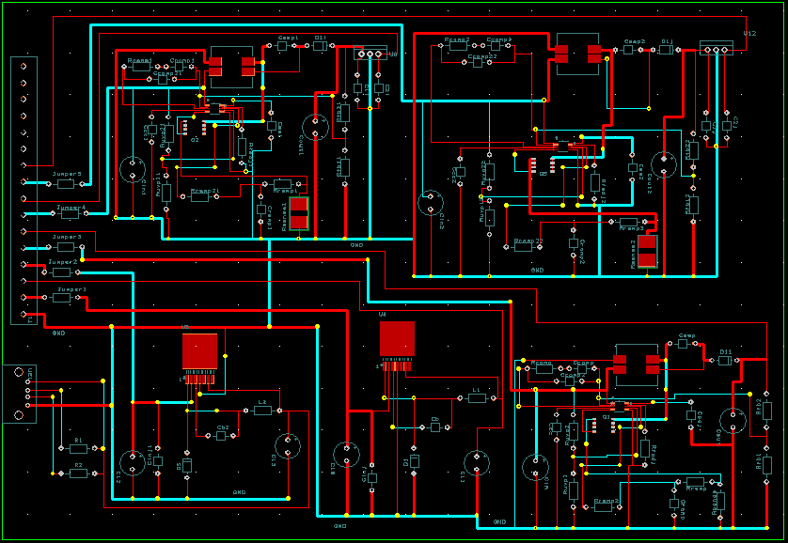
Voltage Regulator Printed Circuit Board

Slide 55
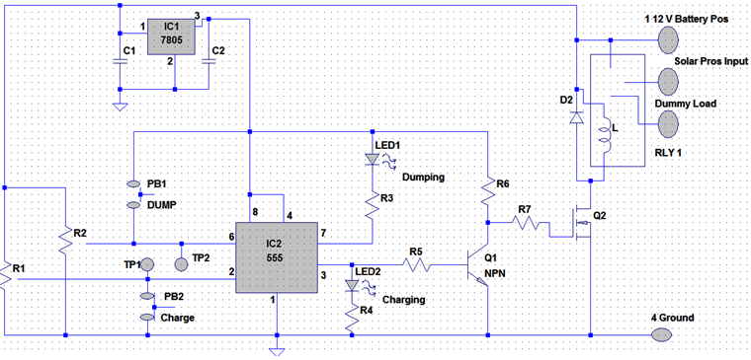
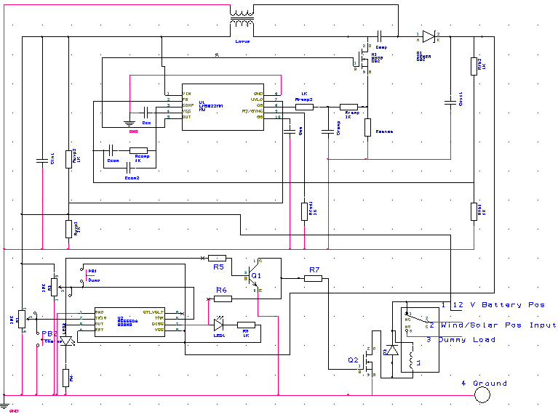
Charge Controller
NE555 controlling the relay
Two calibration points
11.9V=charging & 14.2V=dumping
Switching regulator powering NE555

Slide 56
Administrative

Slide 57
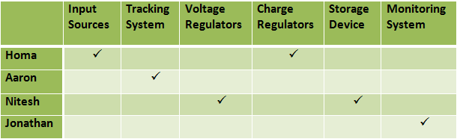
Work Distribution

Slide 58
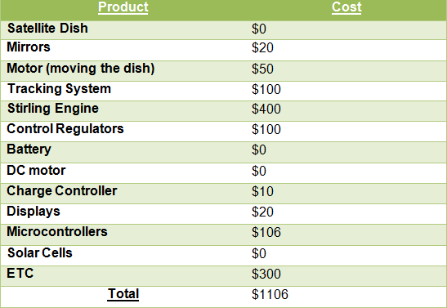
Budget and Financing

Slide 59

Design Issues
Stirling engine performance
Mechanical issues with tracking system
Voltage Regulators

Slide 60
Questions?

